Slide 1
Introduction to scRNA-seq
Stem Cell Network Workshop
David Cook
Postdoctoral Fellow, Wrana Lab
Lunenfeld-Tanenbaum Research Institute
@DavidPCook | david.cook@uottawa.ca

Slide 2
Design
Analysis
Why single cells?
Single-cell platforms
Sample preparation
Design considerations
Cost
How deep to sequence?
How many cells?
How many samples?
Choosing your ecosystem
Standard preprocessing
Quality Control
Normalization
Feature selection
Dimensionality reduction
Clustering & Annotation
To integrate or to not integrate?
Downstream analysis – biological priors help!
Differential expression
Trajectory inference
Signalling / transcription factor inference
Cell-cell communication
Discussion

Slide 3
Design

Slide 4
Why single cells?

Slide 5
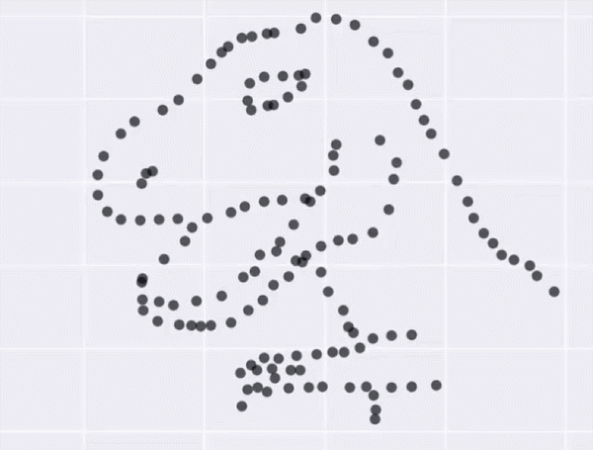
Accuracy—average measurements from complex distributions are meaningless
X Mean:
Y Mean:
X SD:
Y SD:
Corr:
54.26
47.83
16.76
26.93
-0.06
Matejka and Fitzmaurice (Autodesk Research, Toronto)

Slide 6
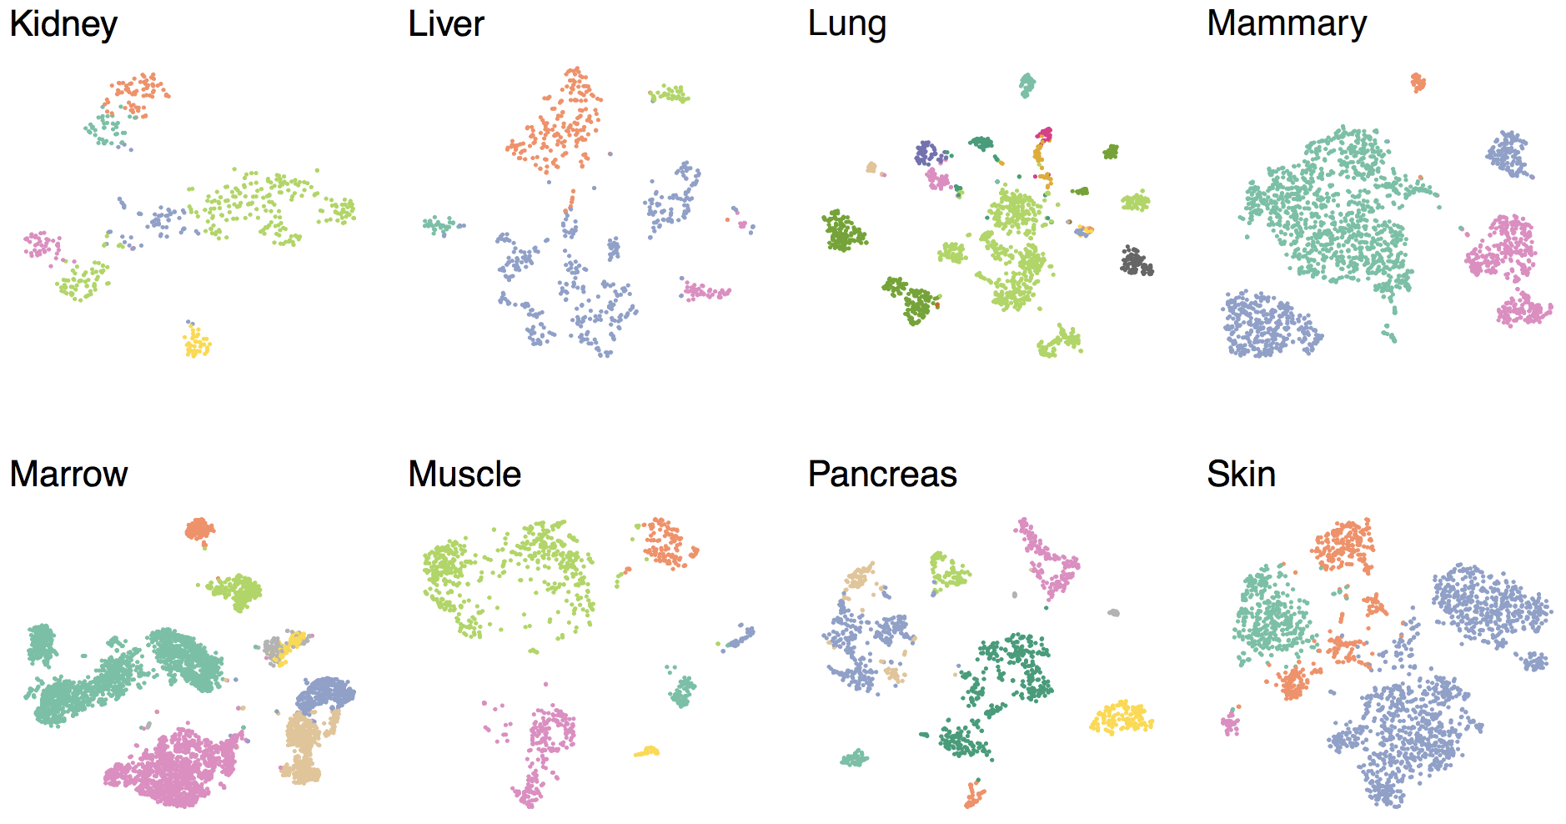
Biological systems are complex – Tissue Heterogeneity
The Tabula Muris Consortium, BioRxiv, 2017

Slide 7
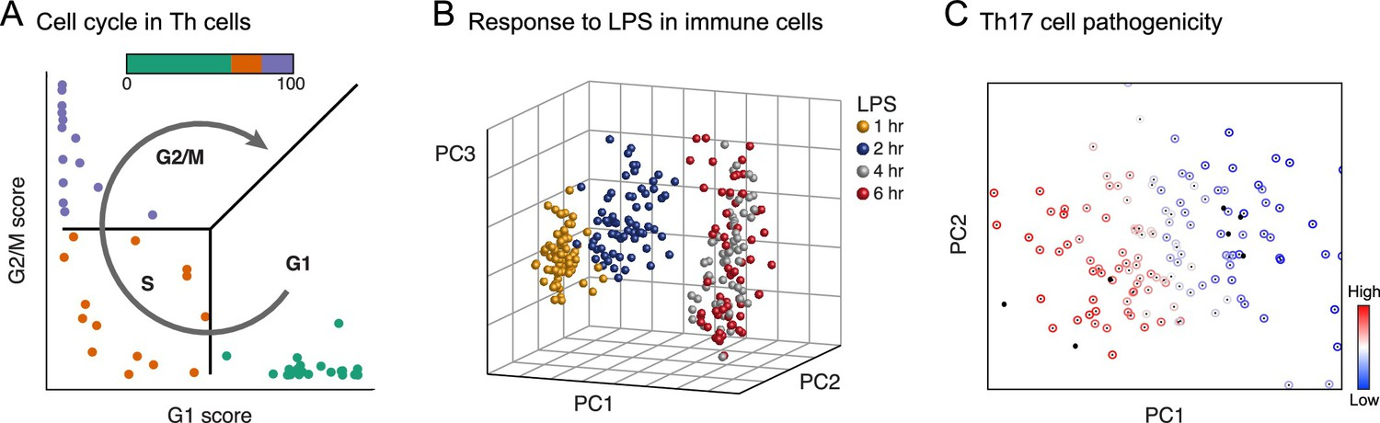
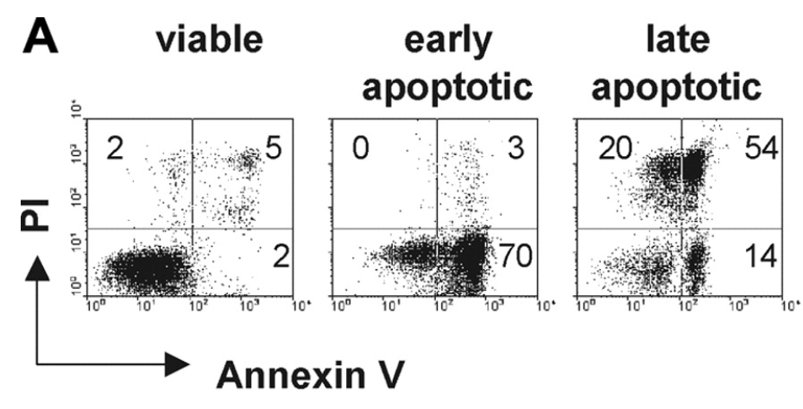
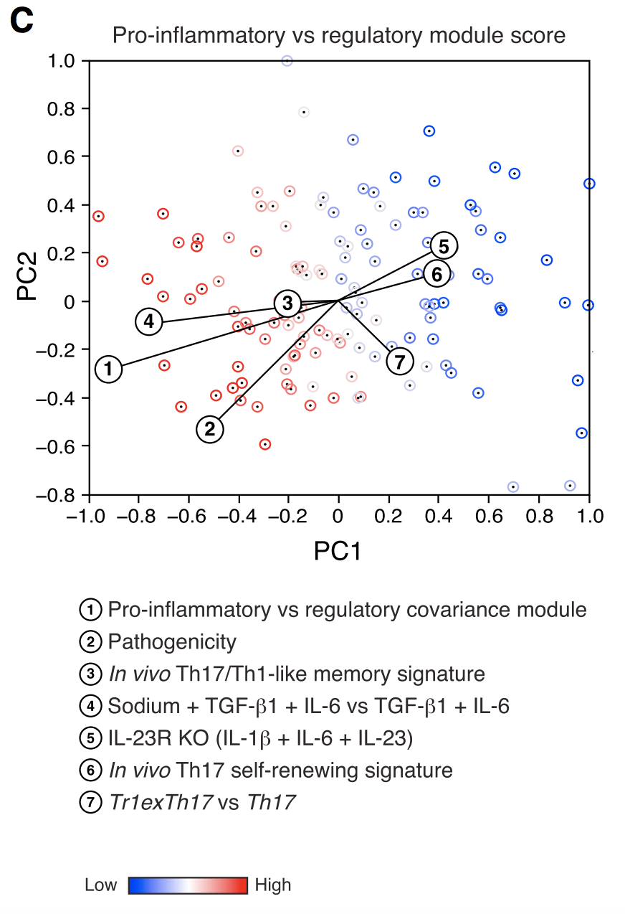
Biological systems are complex – Cellular Heterogeneity
Cell Cycle
Apoptosis/Senescence
Phenotypic spectrum
(eg Th17 T-cells)
The Human Cell Atlas, eLife, 2017
Gaublomme et al., Cell, 2015
Xu et al., Blood, 2006

Slide 8
Single Cell Platforms

Slide 9
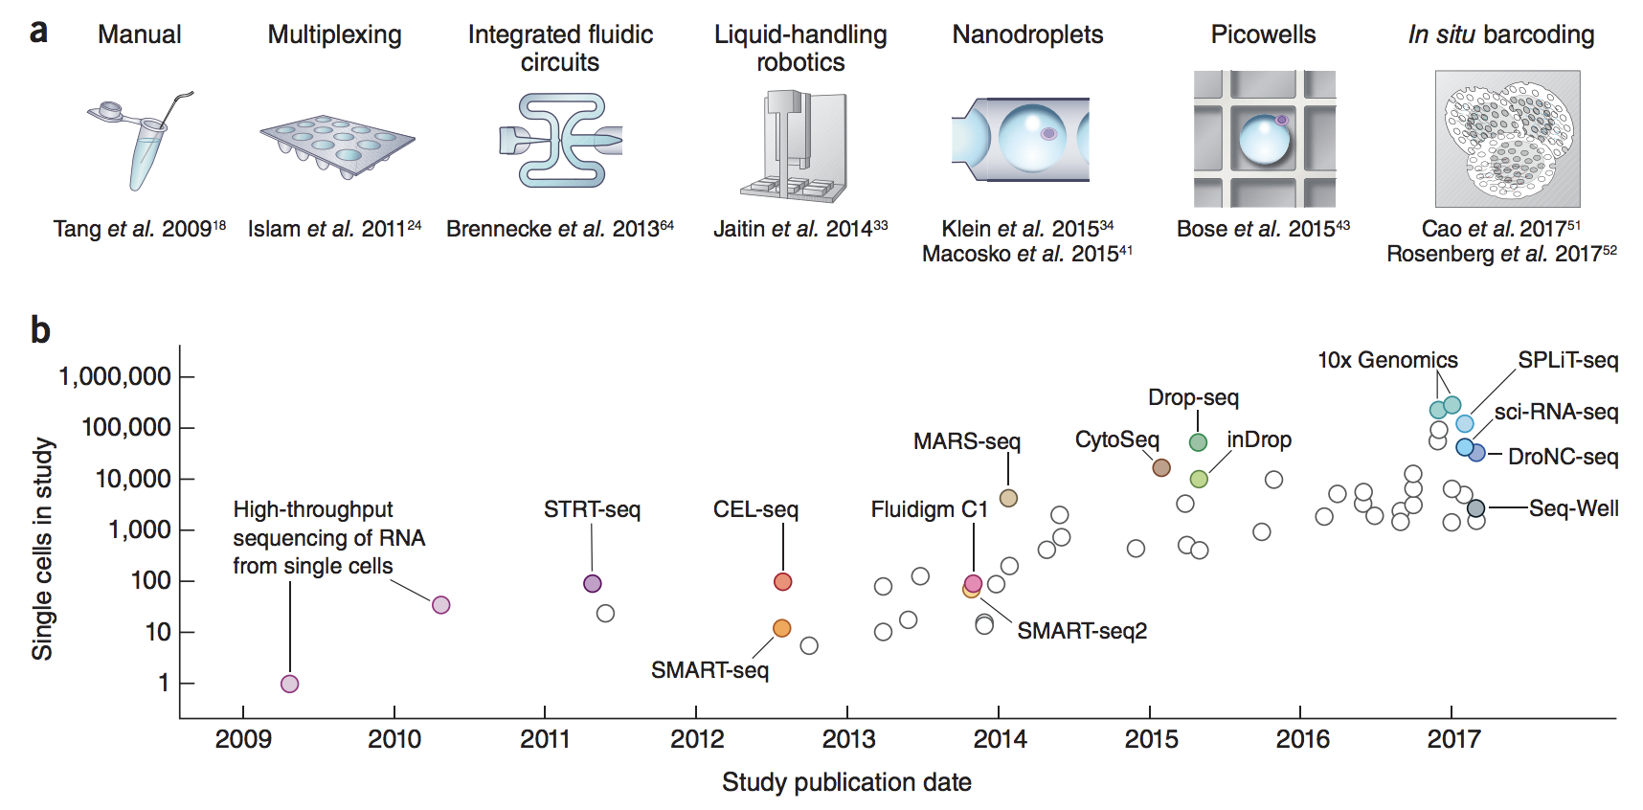
Exponential increase in throughput
Svennson et al., Nature Protocols, 2018

Slide 10
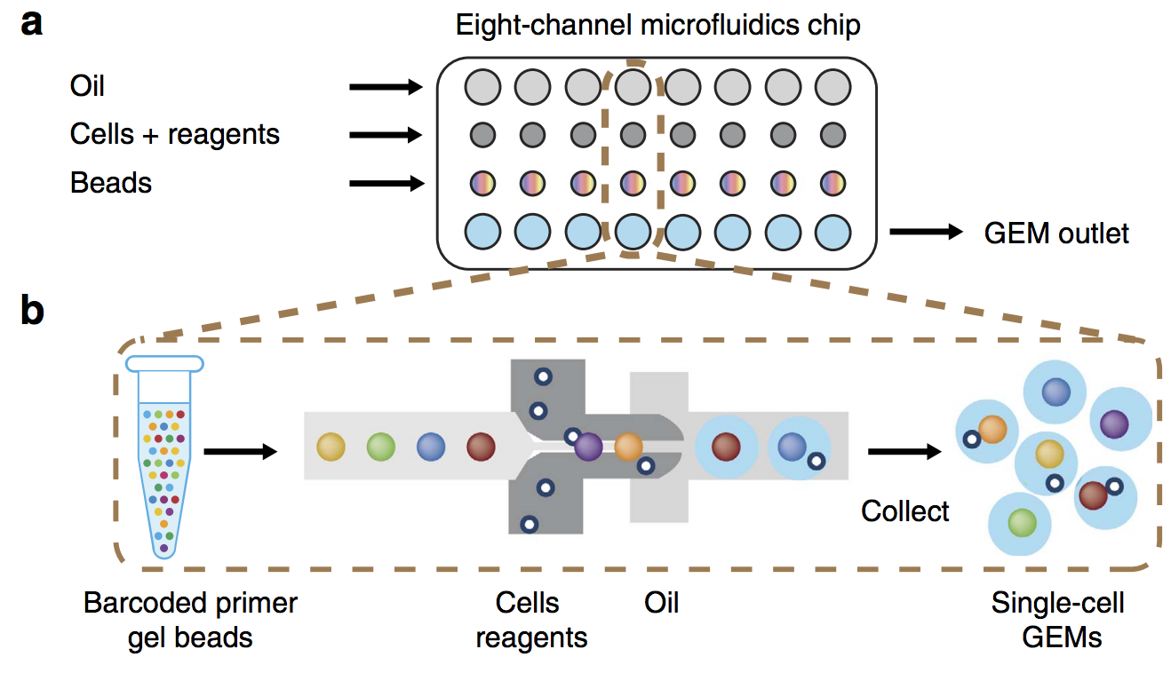
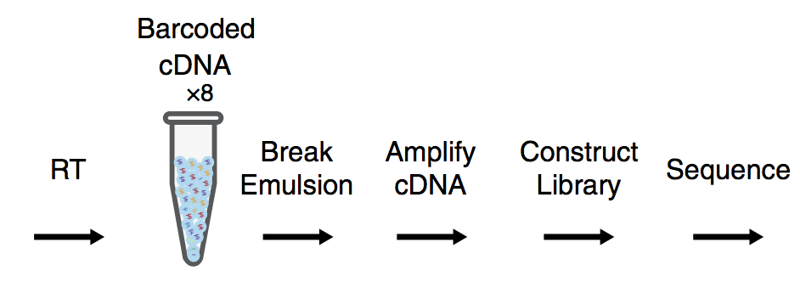
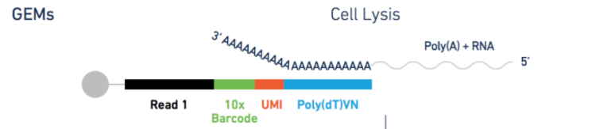
Main platforms – Droplet methods (eg. 10x Genomics Chromium, Drop-Seq)
Pros
Very high throughput
Up to 8 unique samples per run
System cost relatively low
Cons
Limited customizability
Zheng et al., Nature Comm, 2017

Slide 11
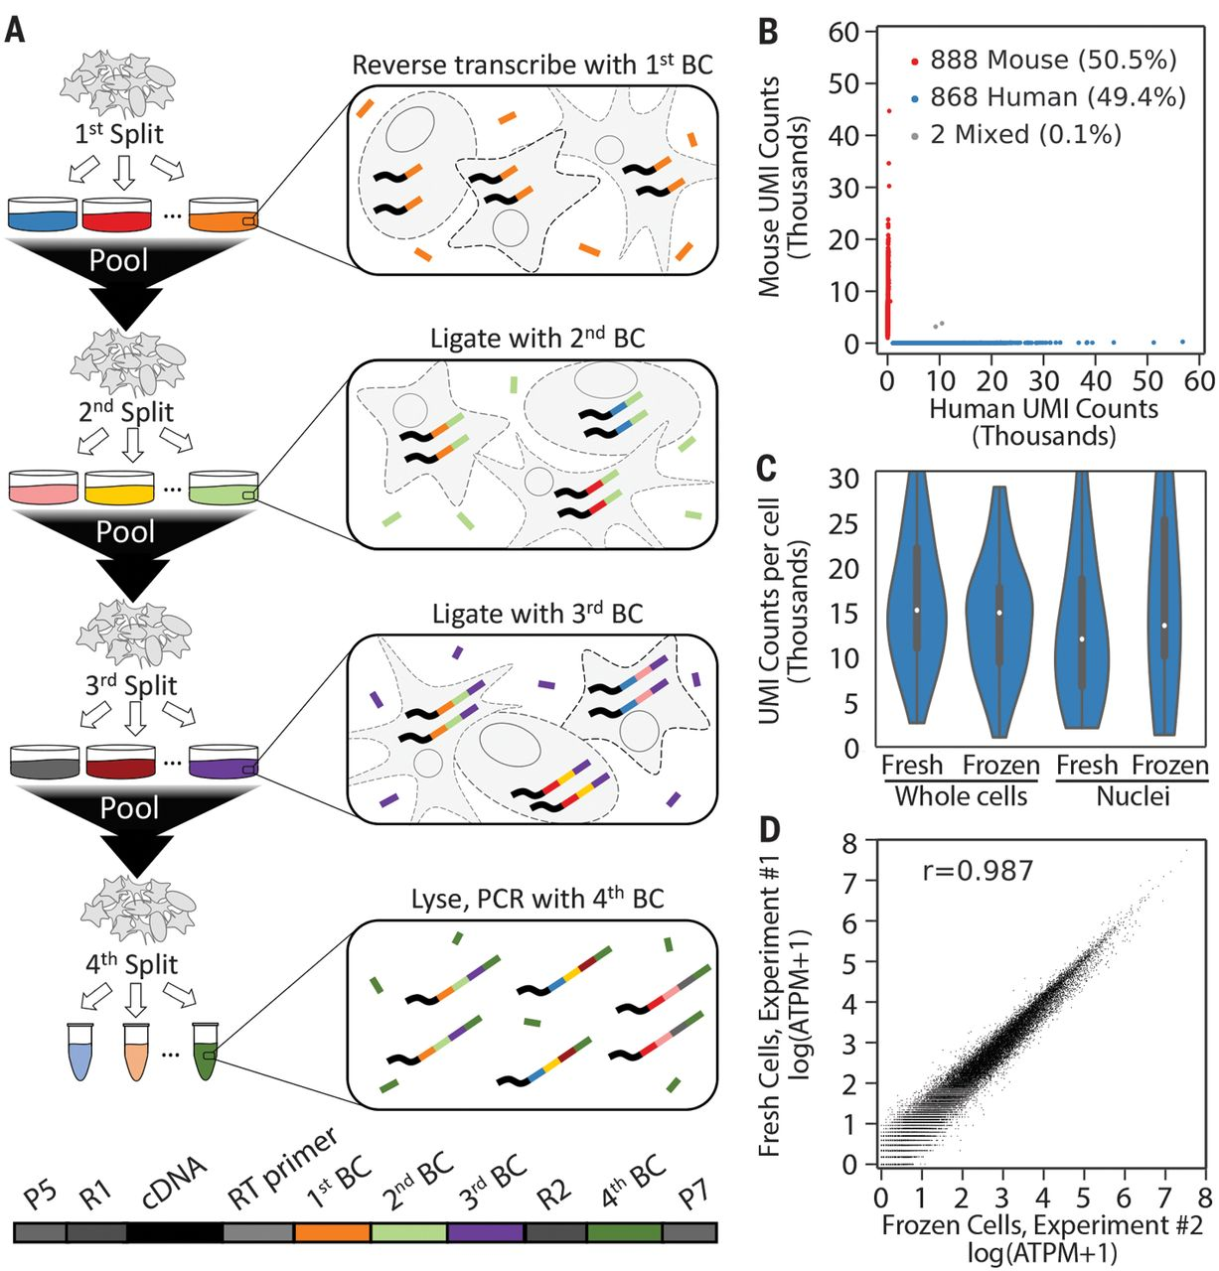
Main platforms – Combinatorial indexing (eg. Parse Biosciences, sciRNA-seq)
Pros
No hardware/microfluidics needed
More customization
Scalable
Requires fixation
Cons
Much more sample handling than droplet methods
Requires fixation

Slide 12
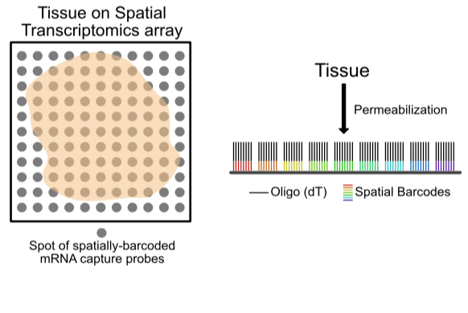
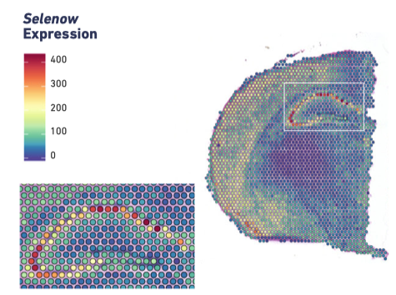
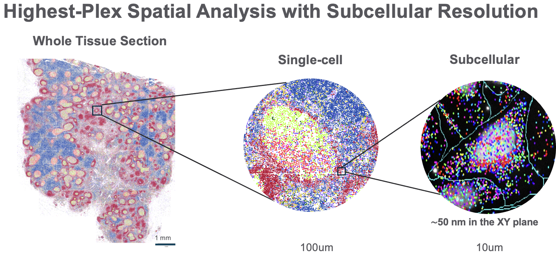
Main platforms – Spatial
Capture Sites - 10x Genomics Visium & SlideSeq
Pros
Whole transcriptome (polyA capture)
Straight forward library prep
Compatible with H&E-stained slides
FFPE or FF
Cons
55um diameter capture sites
Limited resolution (not single cell—yet)
Limited throughput
In Situ Hybridization - Nanostring CosMx & 10x Genomics Xenium
Pros
Subcellular resolution
Can be combined with antibody panels
Cost per slide, not tissue (TMA compatible)
Cons
Hardware cost $$$
Not yet whole transcriptome (only hundreds to 1k genes)

Slide 13
Experimental design considerations

Slide 14
Approximate cost breakdown for 10x Genomics experiment
Consumables
Costs ($CAD)
10x Reagents (Beads, enzyme, etc)
$3000/sample (max throughput = ~10,000 cells/sample)
Microfluidics chip
$320 for an 8-sample chip (consumable; no re-use)
Sequencing options
NovaSeq S2/S4 PE100 Lane
(~2.4B reads = ~96k cells)
$6000
NextSeq500 75-cycle
(~400M reads) = ~16k cells
$3200
Multiplexing methods (eg. TotalSeq Cell Hashing, MULTI-seq, CellPlex) allow you to divide cell yields among pooled samples
(eg. 1x reagents = $3000 per 10k cells / 3 samples = 3000 cells per sample)

Slide 15
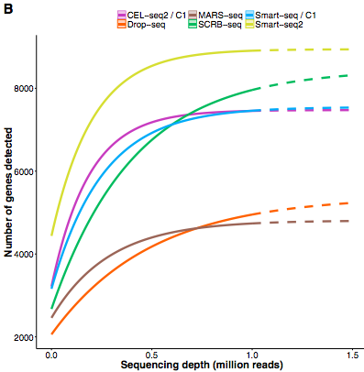
How deep to sequence?
# of genes saturates around 1 million reads
General Rule: “…when the number of individual genes required to answer a given biological question is small, then greater transcriptome coverage is more important than analyzing large number of cells.” Torre et al., Cell Systems, 2018
10x Genomics Recommendation
20-25k reads/cell
Ziegenhain et al., Molecular Cell, 2017
But we don’t necessarily need to detect everything in every cell!

Slide 16
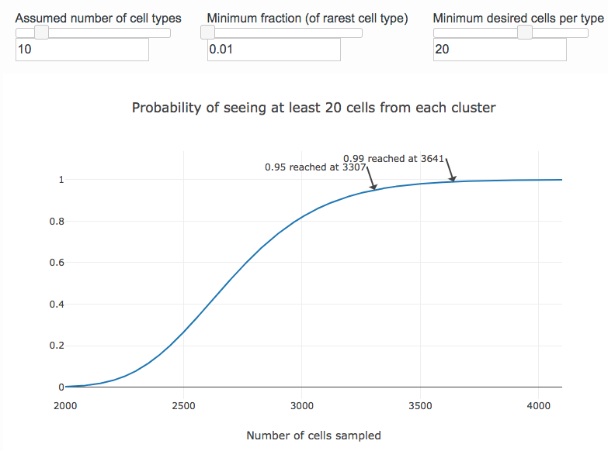
How many cells?
Two main things to consider
How many cell types are there?
What is the proportion of the rarest cell type you’re interested in?
10x Genomics currently allows for each run to yield anywhere from ~500-10,000 cells
Satija Lab “How Many Cells” power calculator
https://satijalab.org/howmanycells
Caution: Do you actually know how many cell types are there? What about cell states? The current trend in the field seems more focused in increasing cell #

Slide 17
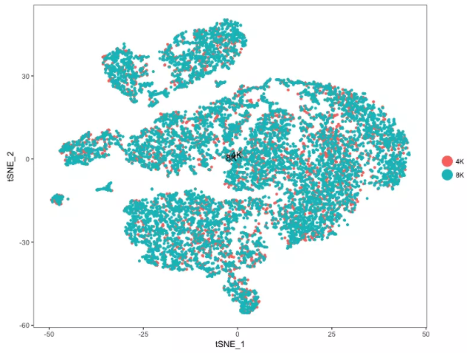
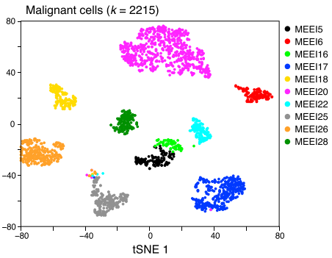
What about replicates?
It kind of depends on the purpose of the experiment
Replicates are always good, but currently, each replicate is quite expensive. They are becoming much more common than they were a couple years ago, but many still do no/few replicates and validate with other methods
Maximize replicates if you can
Pooling unlabelled replicates (eg. multiple mice) doesn’t really solve the problem – multiplex instead!
Minimize sample prep batches as much as possible. Never confound experimental variable with batch (controls collected day X, treated collected day Y)
Technical replicate of PBMCs has near-perfect overlap
Cancer cells differ dramatically between patients
Notes:
What is ”biological variability”? There are different levels

Slide 18
Analysis

Slide 19
Choosing your ecosystem
scRNA-seq analysis involves management of many independent parts (eg. raw/normalized expression matrices, cell metadata, cell embeddings, etc). Various “ecosystems’ have been developed to hold on to all these pieces for you and provide convenient functionality to operate on them
Seurat
Language: R
Tutorial: Link
Pros:
Natively provides most functionality you would need
Very user-friendly for beginners
Most popular ecosystem. Large community of users
Cons:
Development led by a single lab
Most functionality siloed within single package
Sometimes challenging to interact with tools outside the ecosystem
SingleCellExperiment
Language: R
Tutorial: Link
Pros:
Easy interaction with the many R packages through Bioconductor
Ecosystem developed by some very reputably statisticians in the genomics field
Cons:
Common code less intuitive than Seurat
Dependency on diverse packages introduces complexity in standard workfows
scanpy
Language: Python
Tutorial: Link
Pros:
Most functionality needed built directly into scanpy
Data can interact directly with some of the most sophisticated tools
Python is faster than R
Cons:
Python much less friendly to users without coding background
Documentation of python packages often less extensive than R packages

Slide 20
Standard Preprocessing

Slide 21
Standard Preprocessing - Quality Control
Goal
Evaluate the general quality of our data and remove any poor quality (technical or biological) cells that could negatively affect downstream analysis
Three common metrics
Number of measured transcripts per cell Dependent on sequencing depth (reads per cell), transcriptome complexity, and technical variables like lysis/RT efficiency.
Number of unique genes detected per cell Typically correlated well with (1).
Percentage of transcripts per cell associated with mitochondrial genes High percentages associated with dying cells as membrane integrity and cytoplasmic RNAs are lost, enriching for mitochondrial transcripts

Slide 22
Standard Preprocessing - Quality Control
Most tutorials use PBMC data, which is often extremely clean. Many real samples require filtering to remove dead/poor quality cells. Visualize your data!
When in doubt, default to not removing something. You can always see how a certain population affects downstream analysis and then decide if you need to revisit filtering it out.
20%
200
Upper-end thresholds used to be common, assuming they were removing doublets. Can lead to biased removal of specific high-complexity cell types

Slide 23
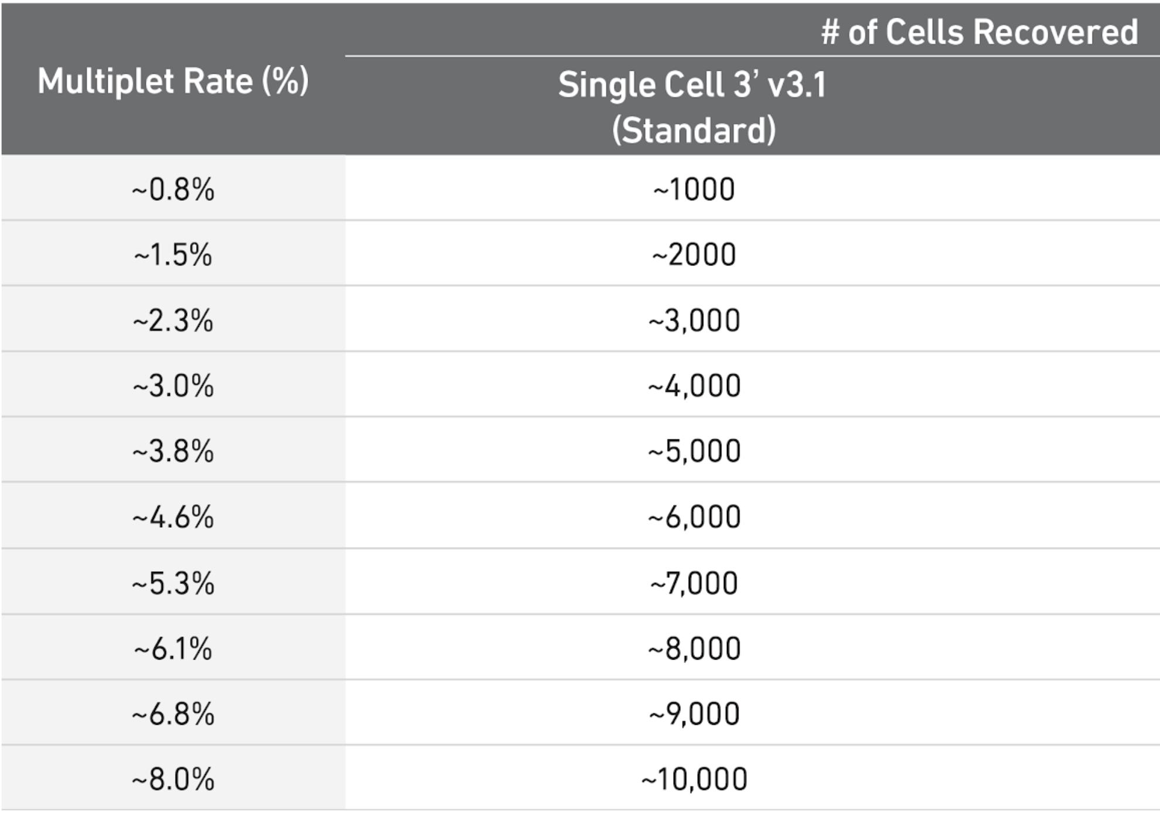
Standard Preprocessing - Quality Control
Doublet removal
With many scRNA-seq experiments pushing to the upper end of the advertised 10k cell yield, a non-trivial percentage of data points will be from >1 cell in a single droplet
Solution #1 – Experimental
Multiplex multiple samples that each contain a sample barcode that can be sequenced (eg. CellPlex, MULTI-seq, Cell Hashing). Datapoints positive for >1 barcode would reflect a doublet. These can be identified and remove from downstream analysis The number of doublets that can be identified is dependent to the number of samples pooled
Solution #2 – Computational
Various methods exist that simulate doublets by aggregating expression profiles of distinct clusters and learning what mixed expression profiles.
Examples
scDblFinder
DoubletFinder
Scrublet Benchmark paper (2021): PMID: 33338399
May not seem like a lot, but in a 10k cell dataset, some relevant clusters will be more rare than this

Slide 24
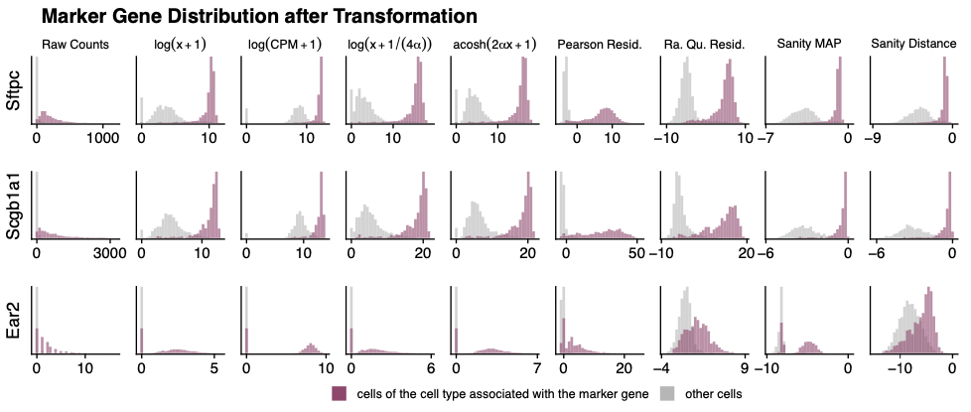
Standard Processing - Normalization
Goal
Correct for depth differences between cells (ie. differences in the # of measured transcripts). Often involves scaling counts to some constant denominator (often 10,000 for scRNA-seq)
Account for variance differences (heteroscedasticity) between genes
Basis of SCTransform
Ahlmann-Eltze & Huber, bioRxiv, 2022
Default normalization in Seurat/Scanpy

Slide 25
If relevant annotations were known for cells at this point, normalized data could be used directly for differential expression
Many single-cell workflows, however, require that we generate low dimensional representations of our data to better evaluate cell-cell similarities in the data

Slide 26
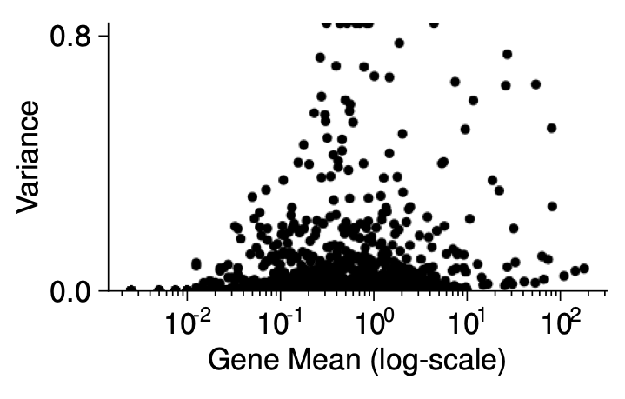
Standard Preprocessing - Feature Selection
Goal
Identify genes that tell us the most about the data structure, eliminate genes that provide little information and/or introduce noise into the downstream analysis
Approach
Most often involves selecting the top n (often 2000-3000) genes with the highest variance across cells
Informative: highly variable genes (eg. cell type markers)
Uninformative: lowly expressed and/or rare detection
Uninformative: highly expressed, but ubiquitous (eg. “housekeeping”)
Ahlmann-Eltze & Huber, bioRxiv, 2022

Slide 27
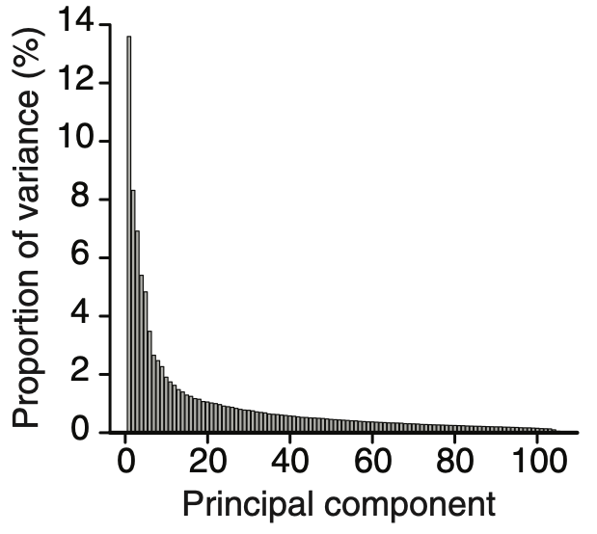
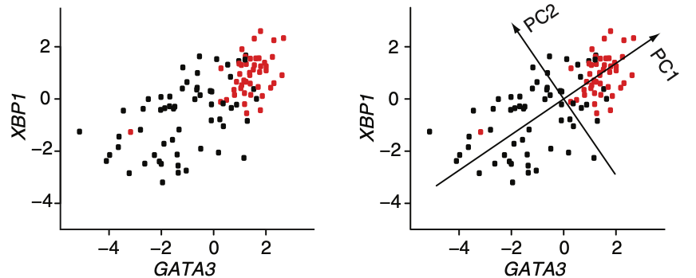
Standard Preprocessing - Principal Component Analysis (PCA)
Goal
Represent a large percentage of the variation present in the 2000-3000 dimensions (ie. gene) of data with a much smaller number (~20-30) of components by summarizing co-expression patterns
The first PCs reflect largest sources of variation in the data
“Plateaued” PCs often reflect noise. Their omission from downstream analysis tends to improve signal
Ringnér, Nat Biotech, 2008
The first 20-30 principal components (PCs) are a low dimensional representation of the data the serves as an input for many downstream analyses, including clustering, UMAP, trajectory inference

Slide 28
Standard Preprocessing - Non-linear dimensionality reduction
Goal
Typically—to represent high dimensional data in two dimensions to allow for effective visualization
Approach
Often involves applying algorithms that evaluate cell-cell similarity in higher dimension space (often PCA space) and then try to position data points in 2D in a way that best matches(big oversimplification but you get my point)
17,157 cells from mouse intestine
How to (mis)read UMAP – LINK
Embedding highly dependent on hyperparameters
Cluster sizes in a UMAP plot mean nothing
Distances between clusters might not mean anything
Random noise doesn’t always look random
UMAP IS NOT A CLUSTERING ALGORITHM
Alternatives embedding methods
Graph embeddings (eg. SPRING), tSNE, Diffusion map, PHATE

Slide 29
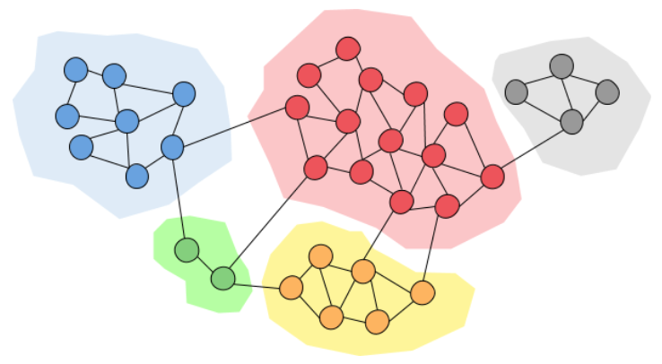
Standard Preprocessing - Clustering
Goal
Define discrete groups of similar cells, often aiming to identify distinct cell types in the data
Approach
Most single-cell clustering workflows involve graph-based clustering:
Build a nearest-neighbor graph of your data from PCA space. Each node is a cell, and each node is connected to its k most similar cells
Apply a “community detection” algorithm (eg. Louvain or Leiden) on the graph to define cluster boundaries, optimizing for high connectivity within boundaries, minimal connectivity between communities

Slide 30
Standard Preprocessing - Clustering
Resolution
A user-defined parameter specifying the granularity of the clustering
Methods exist to evaluate clustering (eg. silhouette width). Quantitatively “best” resolution is not necessarily relevant biologically
Advice
Choose a resolution that matches the “resolution” of your study
Approach clustering with biological priors. Eg. Does it seem reasonable that there are 10 different fibroblast populations in your tissue?
If dealing with a complex sample, consider a first-pass of low-resolution clustering, then subset major populations and re-cluster (avoid over-clustering

Slide 31
Cell Type Annotation - Manual
Goal
Map literature-defined cell type markers to clusters
???
Differential expression to identify cluster 6 markers: eg.
Prnp – Expressed in CNS
Plp1 – Myelin protein
Apoe – KO affects enteric glial cells
Cluster 6 = enteric glial

Slide 32
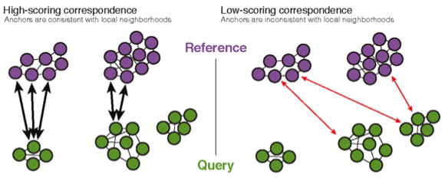
Cell Type Annotation - Automated
Goal
Use a well-annotated/vetted reference dataset to predict the identity of each cell in your data
Approach 1 – Using a reference scRNA-seq dataset
(eg. Seurat’s label transfer method)
Automated annotation using gut cell atlas from the Human Cell Atlas

Slide 33
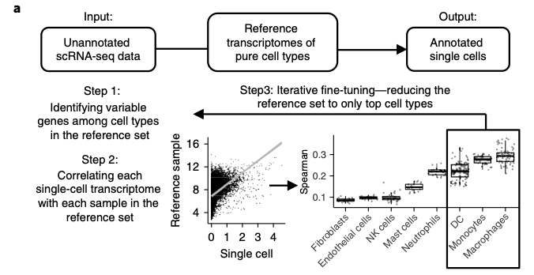
Cell Type Annotation - Automated
Goal
Use a well-annotated/vetted reference dataset to predict the identity of each cell in your data
Approach 2 – Using references of “pure” expression patterns
(eg. Methods: SingleR, CellAssign; Signature Database: celldex)
Challenges
Most automated methods annotate at the level of individual cells. Depending on the reference/query datasets, this can lead to occasional low confidence labels. Eg. cell type mismatch in query/reference samples can lead to inappropriate labels.
Advice
Interpret annotations with biological priors
Sometimes annotations can be cleaned up by applying a “majority rules” label to all cells belonging to a cluster
Many reference atlases contain high-resolution cell type labels (eg. 5 different fibroblast subtypes). Just as with clustering, don’t hesitate to aggregate common labels into a lower resolution grouping (eg. “Fibroblasts”) if that is more appropriate for your study
SingleR: Aran et al., Nat Imm, 2019

Slide 34
To integrate or to not integrate

Slide 35
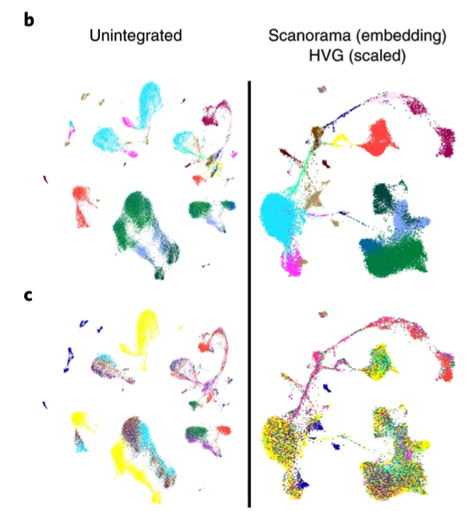
Integration
Both experimental (eg. treatment, genotype, etc) and technical (eg. batch, technology) variables can introduce gene expression or measurement differences that lead to divergence of populations in low dimensional embeddings
Colored by:
PBMCs +/- IFNb
Cell type
Batch
Luecken et al., Nat Methods, 2021

Slide 36
Integration
Integration allows for the correction/removal of some variable for the purpose of aligning samples for low dimensional embedding and clustering. Eg. clusters represent cell types regardless of experimental condition/batch
Integration is not performed for the purpose of correcting expression values for differential expression or exploration!!! If needed, experimental batch should be included as a covariate in DGE regression models
Integrated clusters (cell types)
Re-embed, retain integrated clusters
Integration
Differential expression between samples within same cluster using uncorrected expression values

Slide 37
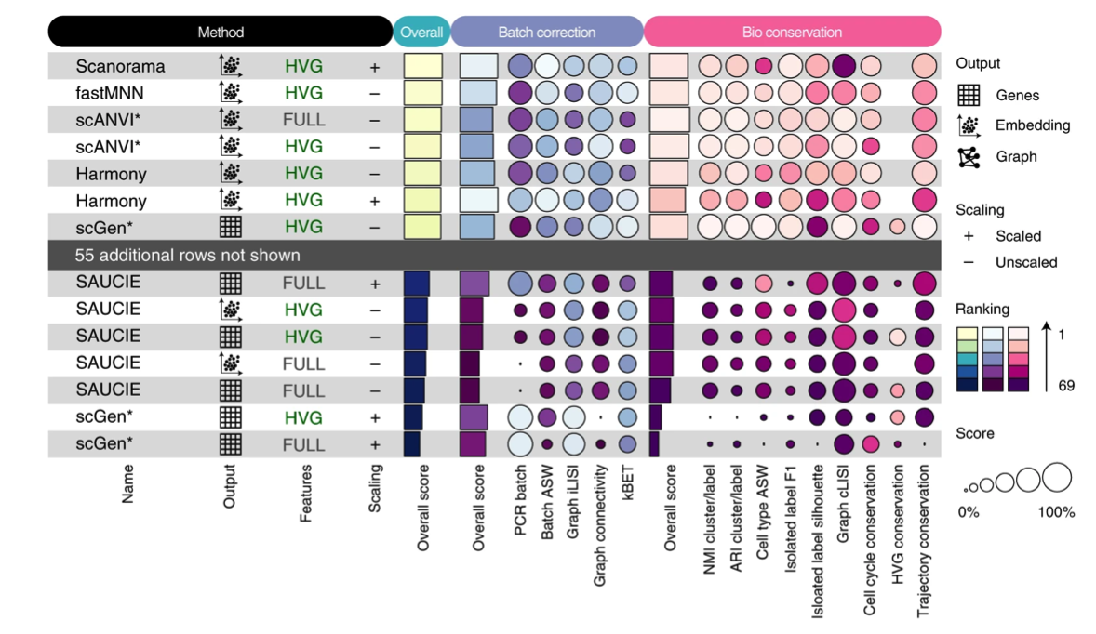
Integration
Integration methods must balance bioconservation and batch removal. We don’t want to overcorrect and remove differences associated with cell type composition (eg. forcing a novel population into another cell type) or relevant phenotypic variability (eg. cell cycle state, differentiation status)
Benchmark of 68 method+preprocessing combinations:
Luecken et al., Nat Methods, 2021

Slide 38
Downstream Analysis
Differential Expression

Slide 39
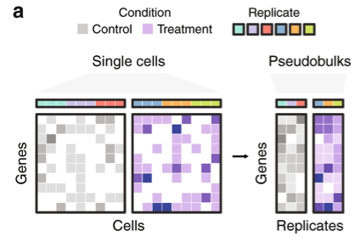
Differential Expression
Goal
Use statistical approaches to evaluate expression differences between defined groups of cells
Best Practice
If independent biological replicates have been used, “pseudobulk” expression profiles for each group (eg. cluster) can be generated for each sample and tools developed for bulk RNA seq (eg. DESeq, edgeR) can be used to test for differential expression
To dig into this and the comparison with methods that use single-cell measurements, see Squair et al., Nat Comm, 2021
If you are in the stages of planning experiments and are not comfortable with the cost of including replicates, consider the possibility of using multiplexing strategies to pool samples for processing. Eg. CellPlex, MULTI-seq, Cell Hashing, SNP-based multiplexing

Slide 40
Differential Expression
Common Practice
Treat each cell as an independent replicate and perform a non-parametric test (eg. Wilcoxon rank sum test) between groups of cells
Marker Identification
Often test ”one-versus-rest”.
Eg. Cluster 6 vs. all other clusters
Differential expression between conditions
Test within cluster, between samples
(integrated clusters make this more straight forward)
Note: Current approaches aren’t very good at evaluating specificity. I expect to see this change over time

Slide 41
Downstream Analysis
Trajectory Inference

Slide 42
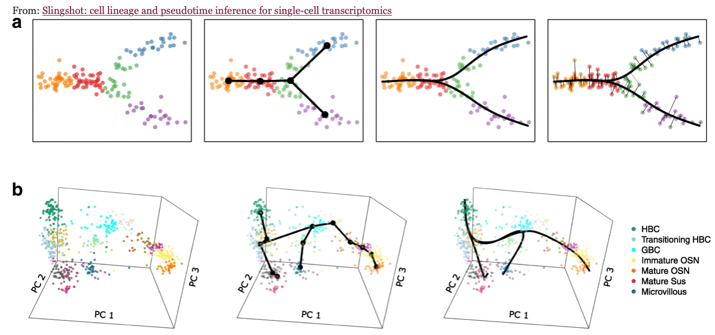
Trajectory Inference
Goal
To infer a continuous phenotypic trajectory from single-cell data
Approach
Given asynchrony/heterogeneity associated with phenotypic dynamics, individual cells may be at different points along a continuum at the time of scRNA-seq processing.
Trajectories are usually defined as an optimal path ”through” the data (eg. diffusion along a nearest-neighbor graph, a principal curve through some low dimensional embedding, etc)
Street et al., BMC Genomics, 2018

Slide 43
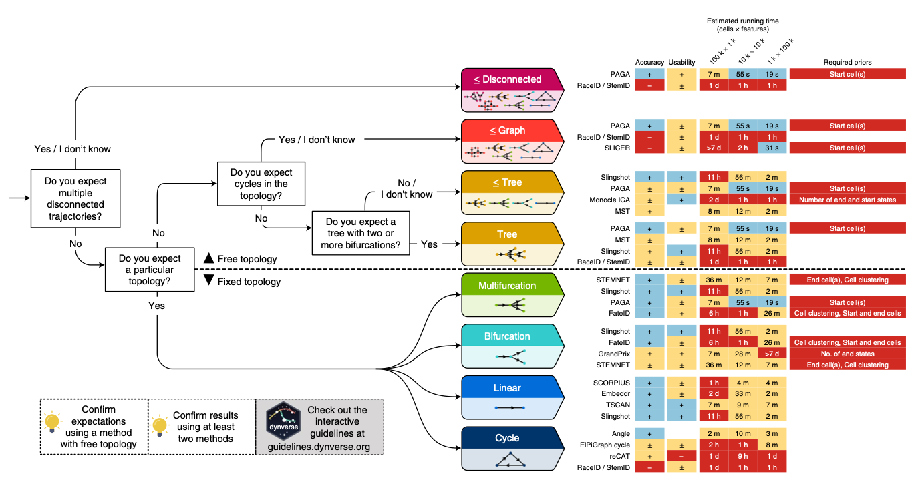
Trajectory Inference
Benchmark of trajectory inference methods
Saelens et al., Nat Biotech, 2019

Slide 44
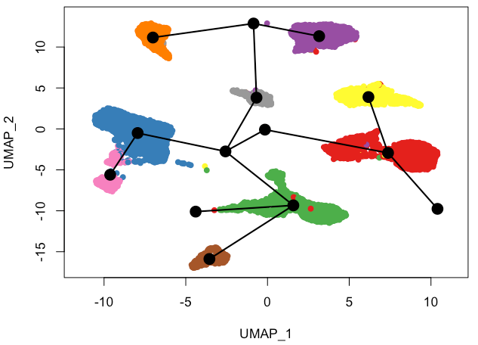
Trajectory Inference
WARNING: Many of these tools will give the “optimal” trajectory given the input data, regardless of whether or not a trajectory makes sense in that data
These tools are not to discover IF a trajectory exists, they build trajectories assuming a trajectory exists
Whole intestinal mesenchyme
Trajectory inference w/ Slingshot
Do not blindly apply these tools and take the results to be some ground truth

Slide 45
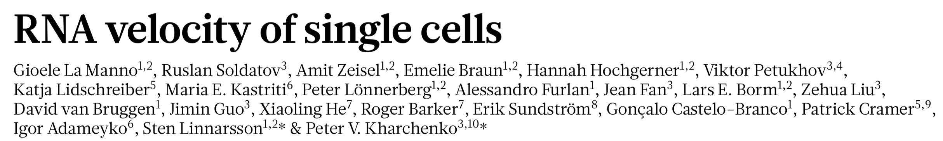
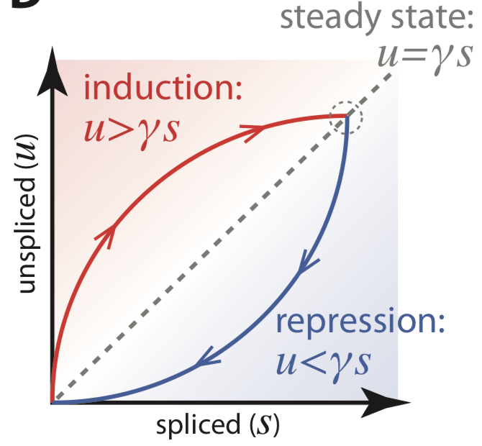
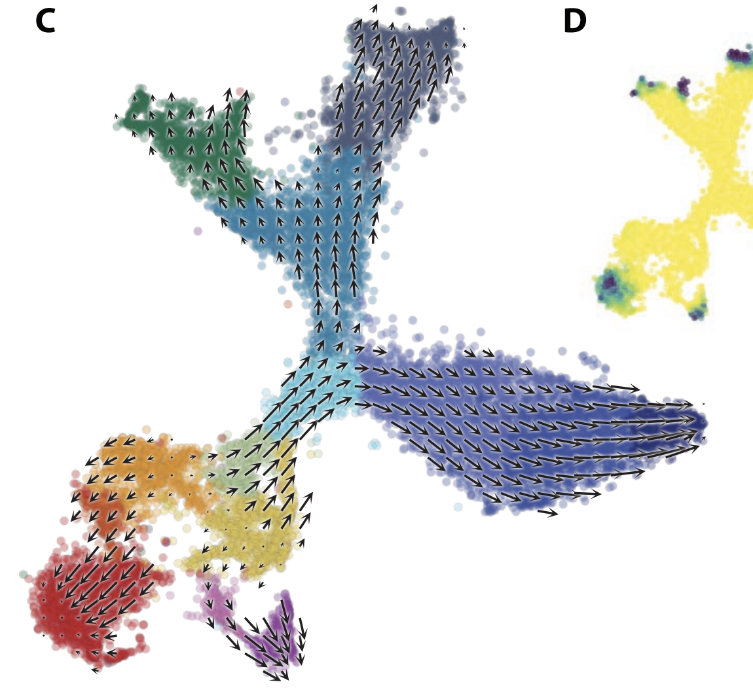
Trajectory inference with RNA velocity
Nature, 2018
Neuroblast differentiation
IMPORTANT: Inferences are limited to a timeframe determined by splicing kinetics (on the scale of hours)
IMPORTANT: Velocity estimates are heavily dependent on parameter selection (see supplemental text to original paper)
IMPORTANT: Remember that UMAP embeddings are are distorted spaces. You cannot project a velocity vector linearly across the embedding and assume that is the target destination
For a highly detailed exploration into details of RNA velocity, see Gorin et al., PLoS Comp Bio, 2022

Slide 46
Downstream Analysis
Signalling and transcription factor activity inference

Slide 47
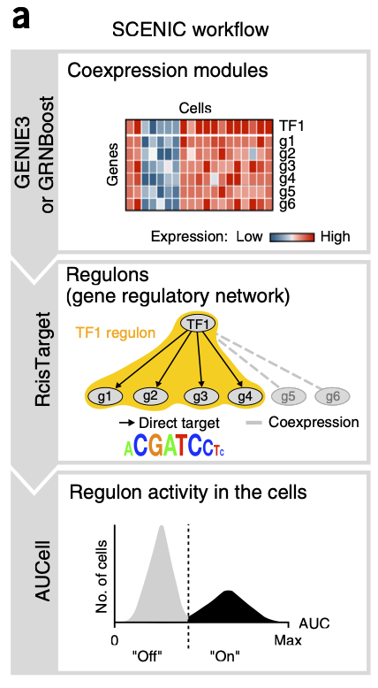
Signalling inference
Goal
Predict the relative activity of signalling pathways and/or transcription factors across cells
Approach 1: De novo gene regulatory network construction
Eg. SCENIC
Approach 2: Use pre-built models/databases with TF/signalling-target relationships, score query data based on signatures
Eg. decoupleR
(14 signalling pathways - PROGENy; transcription factors – DoRothEA)
Higher inferred JAK-STAT signalling by PROGENy in IFNb-treated PBMCs

Slide 48
Downstream Analysis
Cell-cell communication inference

Slide 49
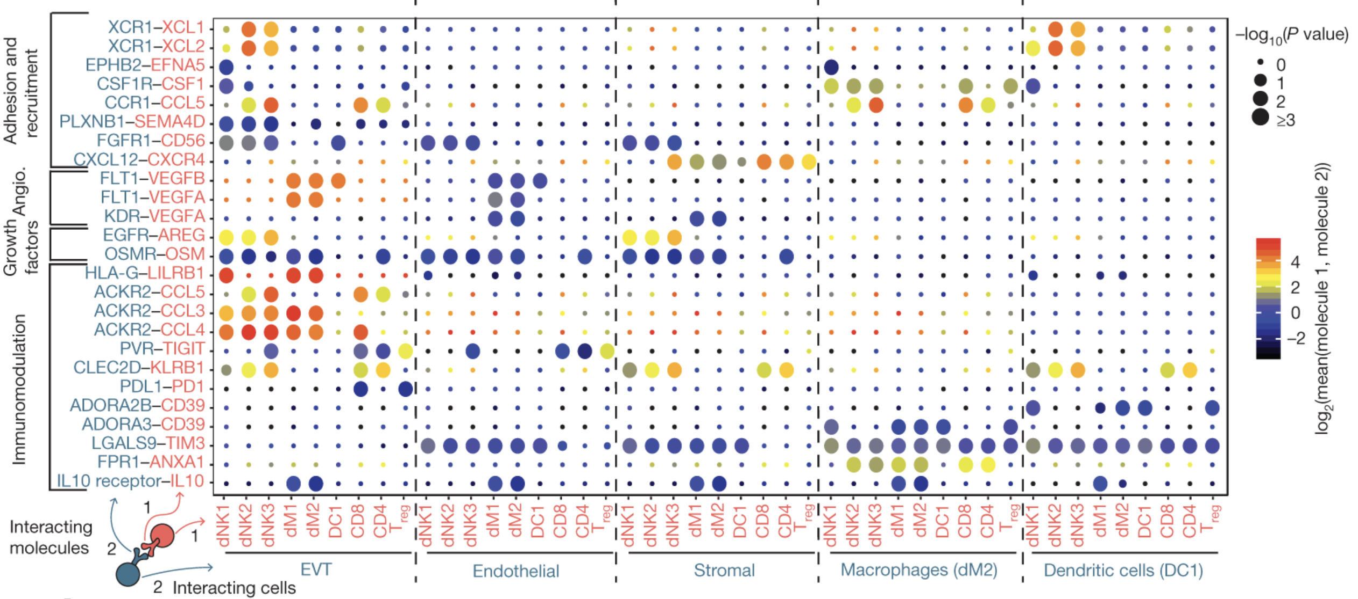
Cell-cell communication inference
Goal
Predict cell communication from the expression patterns of ligands and their cognate receptors
Approach 1: Identify ligand-receptor expression patterns specific to cell type pairs
Eg. CellPhoneDB, CellChat
Vento-Tormo et al., Nature, 2018

Slide 50
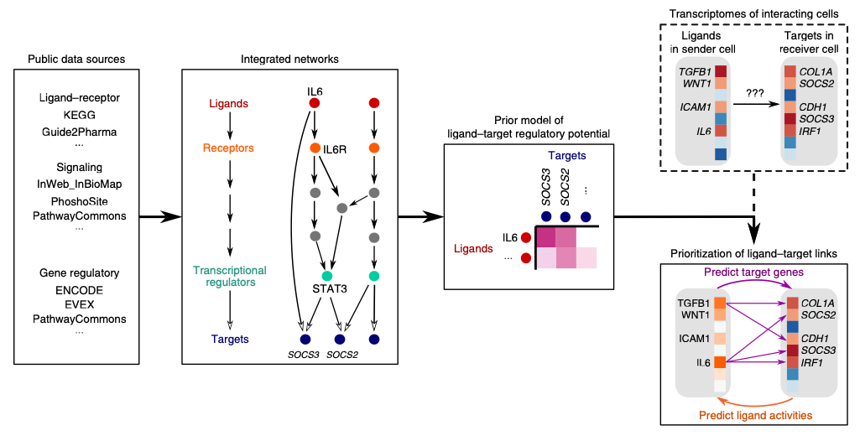
Cell-cell communication inference
Goal
Predict cell communication from the expression patterns of ligands and their cognate receptors
Approach 2: Extend on Approach 1, incorporating intracellular signalling to predict which ligand-receptor pairs are likely driving some query gene expression pattern (eg. a differential expression signature)
Eg. NicheNet
Browaeys, Saelens, & Saeys, Nat Methods, 2019

Slide 51
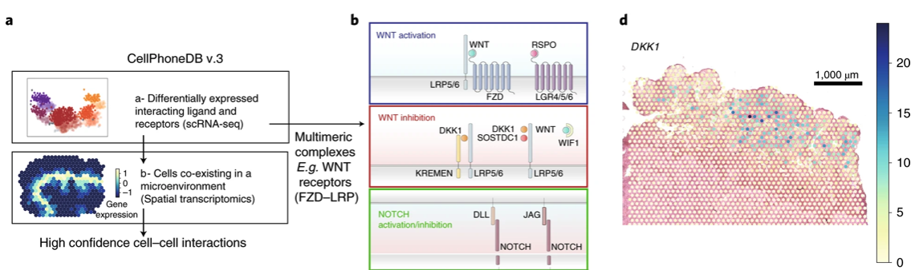
Cell-cell communication inference
Goal
Predict cell communication from the expression patterns of ligands and their cognate receptors
Approach 3: Incorporate spatial data to restrict analysis to adjacent populations
Eg. SpaTalk (Shao et al., Nat Comm, 2022), CellPhoneDB v3 (Garcia-Alonso et al., Nat Genet, 2021)
With spatial methods becoming increasingly available (and utilized), there will likely be many developments on this in the next couple years

Slide 52
General Advice
Be skeptical of all results and double check the details of your code and analysis—just because you didn’t get an error message doesn’t mean that it’s correct
In many cases, I would argue that it’s better to be a biologist first. Biological insight is critical to know if your results make any sense (and to come up with next questions!)
Do you really want to look for trajectories or can we just cluster the cells and do differential expression?
Please don’t over-cluster your data. Cluster count is not proportional to how exciting the data is
Don’t seek help from a colleague at the first sight of an error. Spend time trying to figure out why you’re getting it. It’s a pain, but it’s an incredible learning opportunity
The Python ecosystem is growing rapidly. If you’re in it for the long run, it wouldn’t hurt to dedicate some time to learning it

Slide 53
Questions?

